Slide 1
Chapter 5
Interconnecting the LANs

Slide 2
Chapter Outline
5.1 Introduction
5.2 The Network Bridge
5.3 The Network Switch
5.4 The Router
5.5 Interconnecting the LANs with the Router
5.6 Configuring the Network Interface –
Auto-negotiation

Slide 3
Chapter Outline
5.1 Introduction
5.2 The Network Bridge
5.3 The Network Switch
5.4 The Router
5.5 Interconnecting the LANs with the Router
5.6 Configuring the Network Interface –
Auto-negotiation

Slide 4
Chapter Outline
5.1 Introduction
5.2 The Network Bridge
5.3 The Network Switch
5.4 The Router
5.5 Interconnecting the LANs with the Router
5.6 Configuring the Network Interface –
Auto-negotiation

Slide 5
Chapter Outline
5.1 Introduction
5.2 The Network Bridge
5.3 The Network Switch
5.4 The Router
5.5 Interconnecting the LANs with the Router
5.6 Configuring the Network Interface –
Auto-negotiation

Slide 6
Chapter Outline
5.1 Introduction
5.2 The Network Bridge
5.3 The Network Switch
5.4 The Router
5.5 Interconnecting the LANs with the Router
5.6 Configuring the Network Interface –
Auto-negotiation

Slide 7
Chapter Outline
5.1 Introduction
5.2 The Network Bridge
5.3 The Network Switch
5.4 The Router
5.5 Interconnecting the LANs with the Router
5.6 Configuring the Network Interface –
Auto-negotiation

Slide 8
Chapter Outline
5.1 Introduction
5.2 The Network Bridge
5.3 The Network Switch
5.4 The Router
5.5 Interconnecting the LANs with the Router
5.6 Configuring the Network Interface –
Auto-negotiation

Slide 9
Chapter Objective
Describe how a bridge is used to interconnect LANs.
Describe how a switch is used to interconnect LANs.
Discuss the advantages of using a switch instead of a hub

Slide 10
Chapter Objectives
Describe the function of a router when used to interconnect LANs
Describe the interface associated with a router
Describe the function of a gateway in a computer network
Describe the concept of a network segment
Describe the concept of auto-negotiation

Slide 11
Chapter 5-1
Introduction
The utility of LANs led to the desire to connect two (or more) networks together.
The objective of this chapter and subsequent chapters is to introduce the concepts and issues behind interconnecting LANs

Slide 12
Interconnecting the LANs
Interconnecting LANs in a campus network or even interconnecting LANs in a wide area network (WAN) incorporate similar concepts and issues.
The campus network is a collection of two or more interconnected LANs. Either can be within a building or housed externally in multiple buildings.

Slide 13
Chapter 5-2
The Network Bridge

Slide 14
Network Bridge
A bridge is used in computer networks to interconnect two LANs together and separate network segments.
A segment is a section of a network separated by bridges, switches, and routers.
The bridge is a layer 2 device in the OSI model, meaning that it uses the MAC address information to make decisions regarding forwarding data packets. Only the data that needs to be sent to across the bridge to the adjacent network segment is forwarded.

Slide 15
Port1
Port 2
An example of using a bridge to segment two Ethernet LANs is shown. The picture shows that LAN A connects to port 1 of the bridge and LAN B connects to port 2 on the bridge. This creates two segments as shown in the picture. There are four computers in LAN A and three computers in LAN B.
Bridge
Segment
LAN A
Computer 1
Computer 2
Computer 3
Computer 4
LAN B
Computer 5
Computer 6
Computer 7
Fig. 4-2 Using a bridge to interconnect two Ethernet LANs.

Slide 16
Port1
Port 2
An example of using a bridge to segment two Ethernet LANs is shown. The picture shows that LAN A connects to port 1 of the bridge and LAN B connects to port 2 on the bridge. This creates two segments as shown in the picture. There are four computers in LAN A and three computers in LAN B.
Bridge
Segment
LAN A
Computer 1
Computer 2
Computer 3
Computer 4
LAN B
Computer 5
Computer 6
Computer 7
Fig. 4-2 Using a bridge to interconnect two Ethernet LANs.

Slide 17
Port1
Port 2
An example of using a bridge to segment two Ethernet LANs is shown. The picture shows that LAN A connects to port 1 of the bridge and LAN B connects to port 2 on the bridge. This creates two segments as shown in the picture. There are four computers in LAN A and three computers in LAN B.
Bridge
Segment
LAN A
Computer 1
Computer 2
Computer 3
Computer 4
LAN B
Computer 5
Computer 6
Computer 7
Using a bridge to interconnect two Ethernet LANs.

Slide 18
Port1
Port 2
An example of using a bridge to segment two Ethernet LANs is shown. The picture shows that LAN A connects to port 1 of the bridge and LAN B connects to port 2 on the bridge. This creates two segments as shown in the picture. There are four computers in LAN A and three computers in LAN B.
Bridge
Segment
LAN A
Computer 1
Computer 2
Computer 3
Computer 4
LAN B
Computer 5
Computer 6
Computer 7
Using a bridge to interconnect two Ethernet LANs.

Slide 19
Port1
Port 2
An example of using a bridge to segment two Ethernet LANs is shown. The picture shows that LAN A connects to port 1 of the bridge and LAN B connects to port 2 on the bridge. This creates two segments as shown in the picture. There are four computers in LAN A and three computers in LAN B.
Bridge
Segment
LAN A
Computer 1
Computer 2
Computer 3
Computer 4
LAN B
Computer 5
Computer 6
Computer 7
Using a bridge to interconnect two Ethernet LANs.

Slide 20
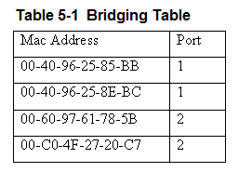
The bridges use the MAC addresses to build a bridging table of MAC addresses and port locations for hosts connected to the bridge ports.
An example of the information contained in a bridging table is provided.
Table 5-1 Bridging Table

Slide 21
The table shows the stored MAC address and the port where the address was obtained.
The source MAC address is stored into the bridge table as soon as a host talks (transmits a data packet) on the LAN.
Table 5-1 Bridging Table

Slide 22
For example, if computer 1 in LAN A sends a message to computer 2 the bridge will store the MAC addresses of both computers and record that both of these computers are connected to port 1.
Port1
Port 2
Bridge
Segment
LAN A
Computer 1
Computer 2
Computer 3
Computer 4
LAN B
Computer 5
Computer 6
Computer 7

Slide 23
If computers 5 or 6 are placing data packets on the network then the source MAC addresses for 5 and 6 are stored in the bridge table and it is recorded that these computers connect to port 2 on the bridge.
Port1
Port 2
Bridge
Segment
LAN A
Computer 1
Computer 2
Computer 3
Computer 4
LAN B
Computer 5
Computer 6
Computer 7

Slide 24
The bridge monitors the data on its ports to check for an association between the destination MAC address of the Ethernet frames to any of the hosts connected to its ports. An association indicates that the destination MAC address for a host is connected to one of the ports on the bridge.
Port1
Port 2
Bridge
Segment
LAN A
Computer 1
Computer 2
Computer 3
Computer 4
LAN B
Computer 5
Computer 6
Computer 7

Slide 25
If an association is found, the data is forwarded to that port. For example, assume that Computer 1 sends a message to Computer 5. The bridge detects an association between the destination MAC address for Computer 5 and port 2. The bridge then forwards the data from Computer 1 to Computer 5 in LAN B via port 2.
Port1
Port 2
Bridge
Segment
LAN A
Computer 1
Computer 2
Computer 3
Computer 4
LAN B
Computer 5
Computer 6
Computer 7

Slide 26
Association
The capability of a bridge to only forward data packets when there is an association is used to isolate data traffic in each segment.

Slide 27
Broadcasts
A potential problem with bridges has to do with the way broadcasts are handled. All broadcasts in a LAN will be forwarded to all hosts connected within the bridged LANs.
For example, the broadcast associated with an ARP will appear on all hosts. In the address resolution protocol, a broadcast is sent to all hosts in a LAN connected to the bridge.

Slide 28
Broadcasts
The bridge forwards all broadcasts. Therefore, an ARP request broadcasting the message “who has this IP address” is sent to all hosts on the LAN.
The data packets associated with ARP requests are small but it requires computer time to process each ARP request.
Excessive amounts of broadcasts being forwarded by the bridge can lead to a broadcast storm resulting in degraded network performance in terms of a network slowdown.

Slide 29
Bridge Table – Expiration Counter
The MAC address entries stored in a bridge table are temporary. Each MAC address entry to the bridge table remains active as long as there is periodic data traffic activity from that host on its port.
However, an entry into the table is deleted if the port becomes inactive. In other words, the entries stored into the table will have a limited lifetime.
An expiration timer will commence once the MAC address is entered into the bridge table. The lifetime for the entry is renewed by new data traffic by the computer and the MAC address is reentered.

Slide 30
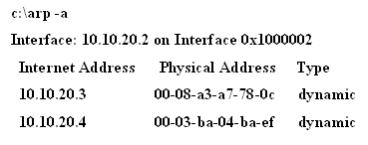
All networking devices (e.g., computers) contain an ARP cache, temporary storage of MAC addresses recently contacted. This is also called the ARP table.
The ARP cache holds the MAC address of a host and this enables the message to be sent directly to the destination MAC address without the computer having to issue an ARP request for MAC address.
The ARP cache contents on a Windows computer can be viewed using the arp –a command while in the command prompt, as shown.

Slide 31

This message is generated if all of the ARP entries have expired.

Slide 32
Transparent Bridge
The name for the type of bridge used to interconnect two LANs running the same type of protocol (e.g. Ethernet) is a transparent bridge.
Bridges are also used to interconnect two LANs that are operating two different networking protocols. For example LAN A could be an Ethernet LAN and LAN B could be a token-ring.

Slide 33
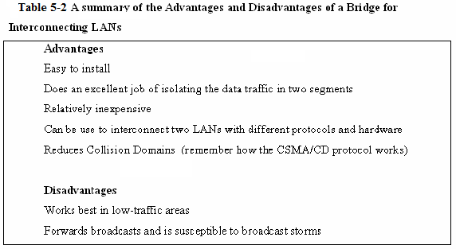
Table 5-2 A summary of the advantages and disadvantages of a Bridge interconnecting LANs.

Slide 34
Bridges - Today
A common application today using a bridge is interconnecting LANs using wireless technology.
The use of wireless bridges in LANs is a popular choice for interconnecting the LANs when the cost of physically connecting the LANs is prohibitive.

Slide 35
Section 5-2 Key Terms
Bridge
Bridging Table
Association
Broadcast Storm
Network Slowdown
ARP Cache
ARP Table
Transparent Bridge

Slide 36
Chapter 5-3
The Network Switch

Slide 37
Network Switch (layer-2)
The layer-2 switch is an improved network technology that addresses the issue of providing direct data connections, minimizing data collisions, and maximizing the use of a LAN’s bandwidth, in other words, that improves the efficiency of the data transfer in the network.
The switch operates at layer 2 of the OSI model and therefore it uses the MAC or Ethernet address for making decisions for forwarding data packets. The switch monitors data traffic on its ports and collects MAC address information in the same way the bridge does to build a table of MAC addresses for the devices connected to its ports.

Slide 38
Network Switch (layer-2)
The switch has multiple ports similar to the hub and can switch in a data connection from any port to any other port similar to the bridge. This is why the switch is sometimes called a multiport bridge. The switch minimizes traffic congestion and isolates data traffic in the LAN.

Slide 39
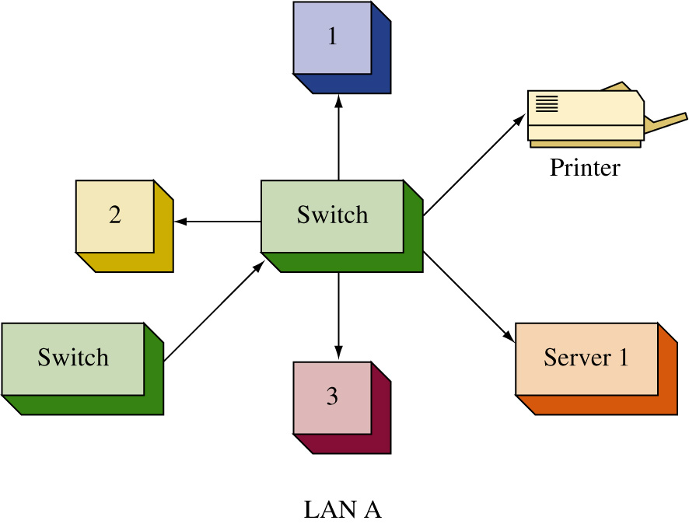
In this figure, the hub has been replaced with a switch. The change from a hub to a switch is relatively easy. The port connections are the same (RJ-45) and once the connections are changed and the device is powered on, the switch begins to make the direct data connections for multiple ports using layer 2 switching.

Slide 40
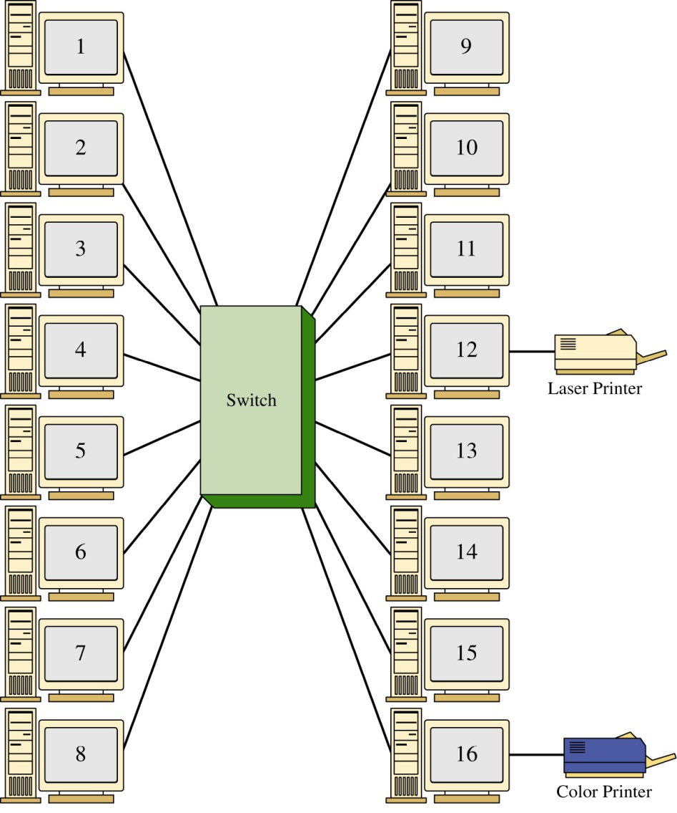
The LAN shown contains 14 computers and 2 printers connected to 16 ports on the switch. The LAN is configured in a star topology.
If the computer connected to port 1 is printing a file on the laser printer (port 12), the switch will set up a direct connect between ports 1 and 12. The computer at port 14 could also be communicating with the computer at port 7 and the computer at port 6 could be printing a file on the color printer at port 16.
The use of the switch enables simultaneous direct data connections for multiple pairs of hosts connected to the network. Each switch connection provides a link with minimal collisions and therefore maximum use of the LAN’s bandwidth.

Slide 41
The LAN shown contains 14 computers and 2 printers connected to 16 ports on the switch. The LAN is configured in a star topology.
If the computer connected to port 1 is printing a file on the laser printer (port 12), the switch will set up a direct connect between ports 1 and 12. The computer at port 14 could also be communicating with the computer at port 7 and the computer at port 6 could be printing a file on the color printer at port 16.
The use of the switch enables simultaneous direct data connections for multiple pairs of hosts connected to the network. Each switch connection provides a link with minimal collisions and therefore maximum use of the LAN’s bandwidth.

Slide 42
The LAN shown contains 14 computers and 2 printers connected to 16 ports on the switch. The LAN is configured in a star topology.
If the computer connected to port 1 is printing a file on the laser printer (port 12), the switch will set up a direct connect between ports 1 and 12. The computer at port 14 could also be communicating with the computer at port 7 and the computer at port 6 could be printing a file on the color printer at port 16.
The use of the switch enables simultaneous direct data connections for multiple pairs of hosts connected to the network. Each switch connection provides a link with minimal collisions and therefore maximum use of the LAN’s bandwidth.

Slide 43
The LAN shown contains 14 computers and 2 printers connected to 16 ports on the switch. The LAN is configured in a star topology.
If the computer connected to port 1 is printing a file on the laser printer (port 12), the switch will set up a direct connect between ports 1 and 12. The computer at port 14 could also be communicating with the computer at port 7 and the computer at port 6 could be printing a file on the color printer at port 16.
The use of the switch enables simultaneous direct data connections for multiple pairs of hosts connected to the network. Each switch connection provides a link with minimal collisions and therefore maximum use of the LAN’s bandwidth.

Slide 44
The LAN shown contains 14 computers and 2 printers connected to 16 ports on the switch. The LAN is configured in a star topology.
If the computer connected to port 1 is printing a file on the laser printer (port 12), the switch will set up a direct connect between ports 1 and 12. The computer at port 14 could also be communicating with the computer at port 7 and the computer at port 6 could be printing a file on the color printer at port 16.
The use of the switch enables simultaneous direct data connections for multiple pairs of hosts connected to the network. Each switch connection provides a link with minimal collisions and therefore maximum use of the LAN’s bandwidth.

Slide 45
The LAN shown contains 14 computers and 2 printers connected to 16 ports on the switch. The LAN is configured in a star topology.
If the computer connected to port 1 is printing a file on the laser printer (port 12), the switch will set up a direct connect between ports 1 and 12. The computer at port 14 could also be communicating with the computer at port 7 and the computer at port 6 could be printing a file on the color printer at port 16.
The use of the switch enables simultaneous direct data connections for multiple pairs of hosts connected to the network. Each switch connection provides a link with minimal collisions and therefore maximum use of the LAN’s bandwidth.

Slide 46
A link with minimal collisions is possible since only the two computers that established the link will be communicating over the channel.
Recall that in the star topology each host has a direct connection to the switch. Therefore, when the link is established between the two hosts, their link is isolated from any other data traffic.
However, the exception to this is when broadcast or multicast messages are sent in the LAN. In the case of a broadcast message, the message is sent to all devices connected to the LAN. A multicast message is sent to a specific group of hosts on the network.

Slide 47
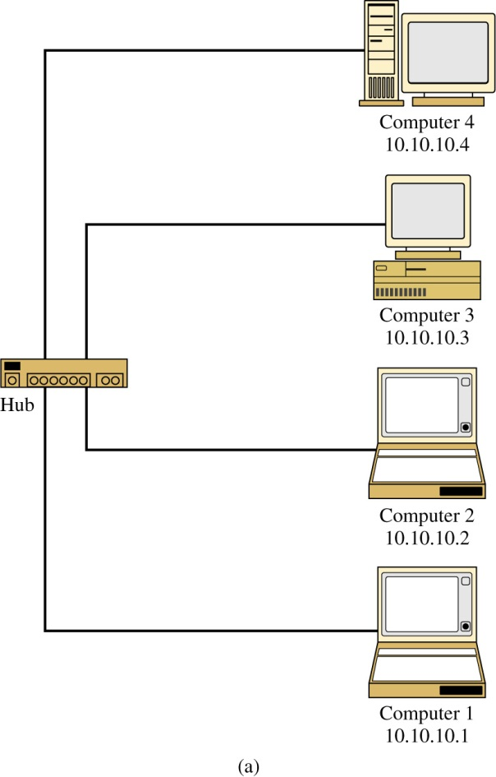
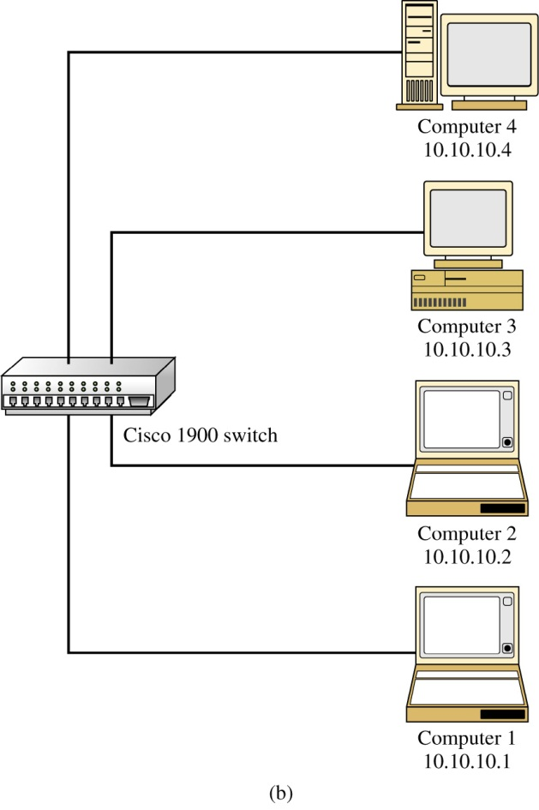
Hub - Switch Comparison
The objective of this experiment was to show that data traffic is isolated with a switch but not with a hub. For this experiment, a LAN using a hub and a LAN using a switch were assembled.
Each LAN contains four computers connected in a star topology. The computers are marked 1 – 4 for reference. The IP addresses are listed for each host .

Slide 48
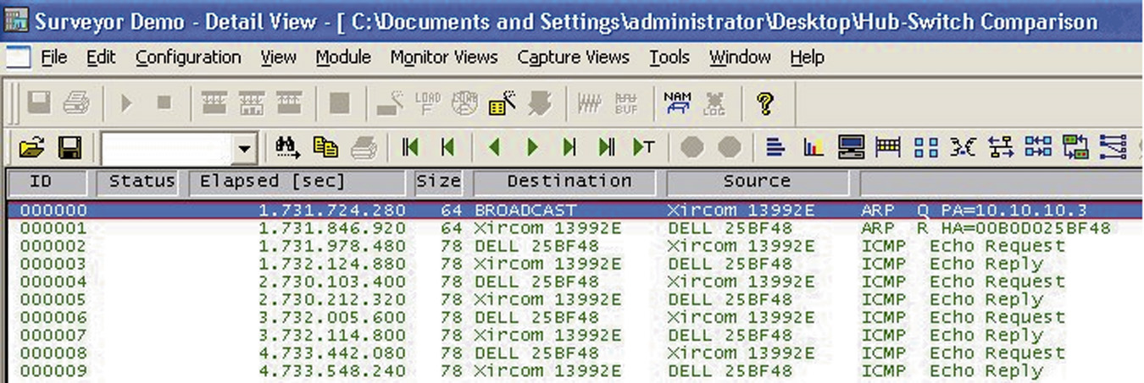

In this experiment, computer 1 pinged computer 3. Computer 2 was used to capture the LAN data traffic using the Surveyor Demo protocol analyzer software. What are the expected results? Remember, a hub is a multiport repeater and all data traffic input to the hub is passed on to all hosts connected to its ports.

Slide 49
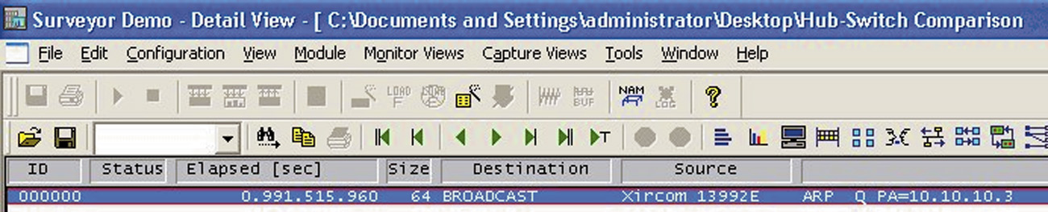
The same experiment was repeated for the LAN shown this time using a switch to interconnect the computers instead of a hub.
This network consists of four computer connected in a star topology using a switch at the center of the network. The ping command was sent from computer 1 to computer 3, ping 10.10.10.3.

Slide 50
Hub – Switch Comparison
The results of this experiment show that the use of the switch substantially reduces data traffic in the LAN and reduces unnecessary data traffic in the LAN.
The experiment shows that the broadcast associated with an ARP request is seen by all computers but not the ARP replies in a LAN using a switch. This is because a direct data connection is established between the two hosts.
The advantage of using switches is true for all data transfers e.g. file transfers, image downloads, file printing, and so on). The data traffic is isolated from other computers on the LAN.

Slide 51
Managed Switch
A managed switch is simply a network switch that allows the network administrator to monitor, configure, and manage certain network features such as what computers are allowed to access the LAN via the switch.
Access to the management features for the switch is password protected so that only the network administrators can gain entry.
The following information describes some of the features of the managed interface for a Cisco Catalyst 2950 switch.

Slide 52

Using the Cisco Network Assistant
The current connections to the ports on the switch can be viewed by clicking on the stacked switch icon at the top of the screen .
The image of the switch port connections shows ports 1,2, and 3 are brighter indicating that there are networking devices connected to the ports.

Slide 53
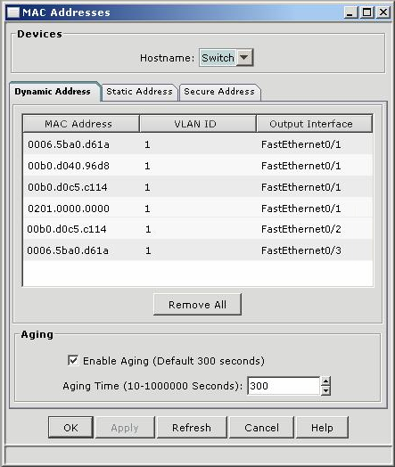
There are:
four MAC addresses assigned to port 1
one MAC address assigned to port 2
one MAC address assigned to port 3
Multiple networking devices can be connected to a port if the devices are first connected to another switch or hub and the output of the switch or hub is connected to one switch port.

Slide 54
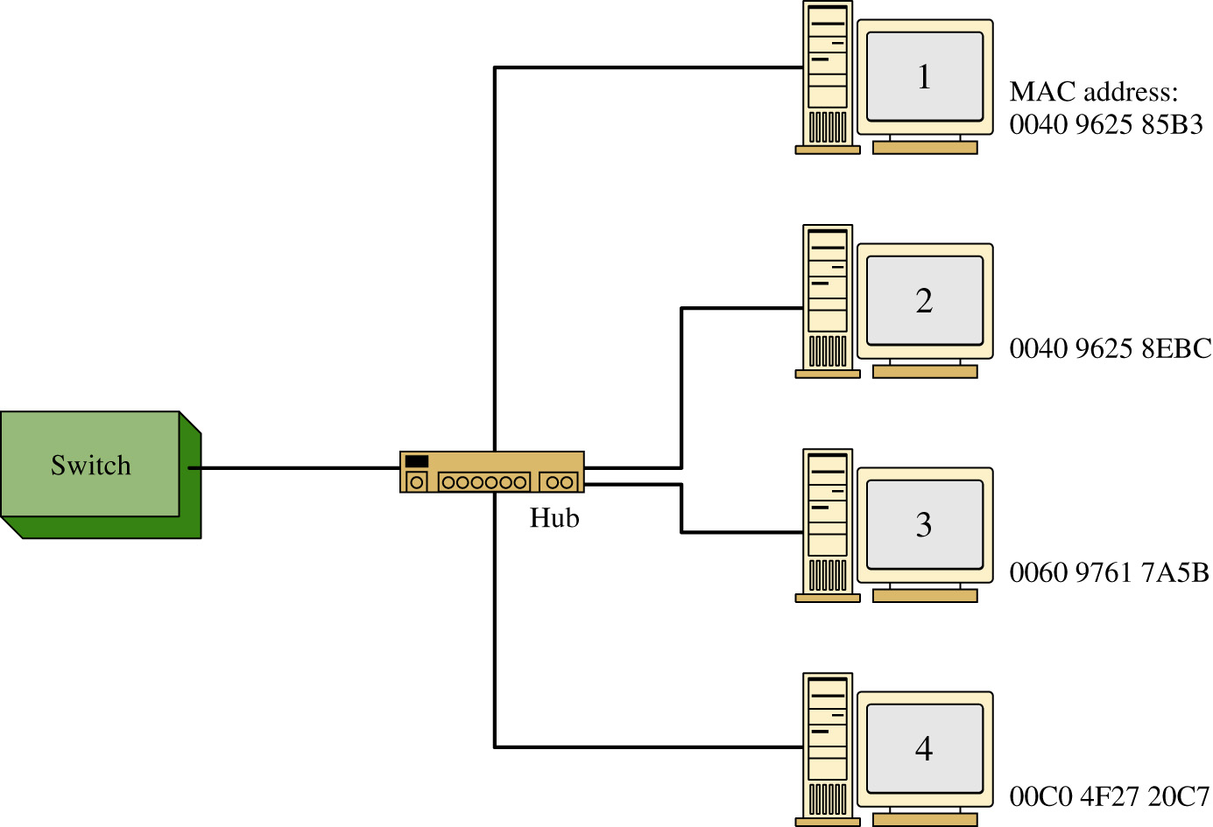
FIGURE 5-12 An example of a hub connected to a switch port, with four computers connected to the hub.

Slide 55
Notice that the Dynamic Address tab is highlighted. This indicates that this is a listing of the MAC addresses that have been assigned dynamically.
Dynamic assignment means that the MAC address was assigned to a port when a host was connected.
There is also a tab for Static Addresses. A static MAC address indicates that the MAC address has been manually assigned to an interface and the port assignment does not expire.

Slide 56
The Secure tab shows what switch ports have been secured.
This means that a MAC address has been assigned to a port and the port will automatically disable itself if a device with a different MAC address connects to the secured port.

Slide 57
The FastEthernet 0/1, FastEthernet 0/2, FastEthernet 0/3 notation indicates the [Interface Type Slot#/Interface#] on the switch and FastEthernet indicates that this interface supports 100 Mbps and 10 Mbps data rate connections.

Slide 58
The “Aging Time” is listed to be 300 seconds. Aging time is the length of time a MAC address remains assigned to a port.
The assignment of the MAC address will be removed if there is no data activity within this time. If the computer with the assigned MAC address initiates new data activity, the aging time counter is restarted and the MAC address remains assigned to the port.
The management window shows a switch setting for enabling “Aging”. This switch is used to turn off the aging counter so that a MAC address assignment on a port never expires.

Slide 59
Switches
The benefits of a using a network switch are many in a modern computer network. These benefits include less network congestion, faster data transfers, and excellent manageability. It has been shown that a network switch can be used to replace the network hub and the advantage is data traffic within a LAN is isolated.
The term for this is isolating the collision domains which is breaking the network into segments. A segment is a portion of the network where the data traffic from one part of the network is isolated from the other networking devices.

Slide 60
Switches
A direct benefit of isolating collision domains is there will be an increase in the data transfer speed and throughput. This is due to the fact that the LAN bandwidth is not being shared and chances of data collisions are minimized.
As a result, the LAN will exhibit faster data transfers and latency within the LAN will be significantly reduced. Reduced latency means that the data packets will arrive at the destination more quickly.

Slide 61
CAM – Content Addressable Memory
Switches learn the MAC addresses of the connected networking by extracting the MAC address information from the headers of Ethernet data packets.
The switch will map the extracted MAC address to the port where the data packet came in. This information is stored in CAM – Content Addressable Memory.
CAM is a table of MAC address and port mapping used by the switch to identify connected networking devices

Slide 62
CAM – Content Addressable Memory
The extracted MAC addresses are then used by the switch to map a direct communication between two network devices connected to its ports.
The MAC address and port information remain in CAM as long as the device connected to the switch port remains active.
A time-stamp establishes the time when the mapping of the MAC address to a switch port is established.
switches limit the amount of time address and port information are stored in CAM. This is called aging time.

Slide 63
Switches – broadcast domain
It has been shown that switches minimize the collision domain due to the fact a direct switch connection is made between networking devices.
However, it is important to remember that switches do not reduce the broadcast domain.
In a broadcast domain, any network broadcast sent over the network will be seen by all networking devices in the same network.
Broadcasts within a LAN will be passed by switches

Slide 64
Switches – modes
There are two modes used in a switch to forward frames.
These are store-and-forward and cut-through.

Slide 65
Switchmodes – Store and Forward
Store-and-Forward - In this mode, the entire frame of data is received before any decision is made regarding forwarding the data packet to its destination.
There is switch latency in this mode because the destination and source MAC addresses must be extracted from the packet and the entire packet must be received before it is sent to the destination.
The term switch latency is the length of time a data packet takes from the time it enters a switch until it exits.

Slide 66
Switchmodes – Store and Forward
An advantage of the store-and-forward mode is the switch checks the data packet for errors before it is sent on to the destination.
A disadvantage is lengthy data packets will take a longer time before they exit the switch and are sent to the destination.

Slide 67
Switchmodes – Cut-Through
in this mode, the data packet is forwarded to the destination as soon as the destination MAC address has been read.
This minimizes the switch latency however, no error detection is provided by the switch.
There are two forms of cut-through switching; Fast-Forward and Fragment Free.

Slide 68
Switchmodes – Cut-Through
Fast-Forward
this mode offers the minimum switch latency.
The received data packet is sent to the destination as soon as the destination MAC address is extracted.

Slide 69
Switchmodes – Cut-Through
Fragment-Free
in this mode, fragment collisions are filtered out by the switch.
Fragment-collisions are collisions that occur within the first 64 bytes of the data packet. Recall from Chapter 1, Table 1-1 that the minimum Ethernet data packet size is 64 bytes.
The collisions create packets smaller than 64 bytes and these fragments are discarded.
Latency is measured from the time the first bit is received until it is transmitted.

Slide 70
Switchmodes – Cut-Through
Adaptive Cut-Through
This is a combination of the store-and-forward mode and cut-through.
The cut-through mode is used until an error-threshold (errors in the data packets) has been exceeded.
The switch mode changes from cut-through to store-and-forward after the error threshold has been exceeded.

Slide 71
Multilayer Switches
Layer 3 switches work at the network layer of the OSI model and use IP addressing for making decisions to route a data packet the best direction. Layer 3 switches are similar to routers in that they also work at layer 3 and use the network address for making routing decisions.
Layer 4 switches operate at the transport layer of the OSI model. Layer 4 coordinates the communications between network systems. The layer 4 switch identifies the application protocols included with each packet and can then hand off the packet to the appropriate higher level software.

Slide 72
Section 5-3 Key Terms
Layer-2 Switch
Multiport Bridge
Multicast
Managed Switch
Hyperterminal
Dynamic Assignment
Aging Time

Slide 73
Chapter 5-4
The Router

Slide 74
the Router
The router is a layer 3 device in the OSI model, which means the router uses the network address (layer 3 addressing) to make routing decisions regarding forwarding the data packets.
Remember, the OSI model separates the network responsibilities into different layers. In the OSI model, the layer 3 or Network layer responsibilities include handling of the network address.
The network address is also called a logical address rather than a physical address such as the MAC address. The logical address describes the IP address location of the network and the address location of the host in the network.

Slide 75
the Router
Basically the router is configured to know how to route data packets entering or exiting the LAN. This differs from the bridge and the layer 2 switch which use the Ethernet address for making decisions regarding forwarding data packets and only know how to forward data to hosts physically connected to their ports.

Slide 76
The Router
Routers are used to interconnect LANs in a campus network.
The networks can use the same protocol (e.g. Ethernet) or they can be used to interconnect LANs that are using different layer 2 technologies such as a Ethernet and token-ring.
Routers also make it possible to interconnect to LANs around the country and the world and interconnect to many different networking protocols.

Slide 77

the Router
Routers have multiple port connections for connecting to the LANs and by definition, a router must have a minimum of three ports.
The common symbol used to represent a router in a networking drawing is provided. The arrows pointing in and out indicate that data enters and exits the routers through multiple ports. The router ports are bi-directional, meaning that data can enter and exit the same router port.
Often the router ports are called the router interface, the physical connection where the router connects to the network.

Slide 78
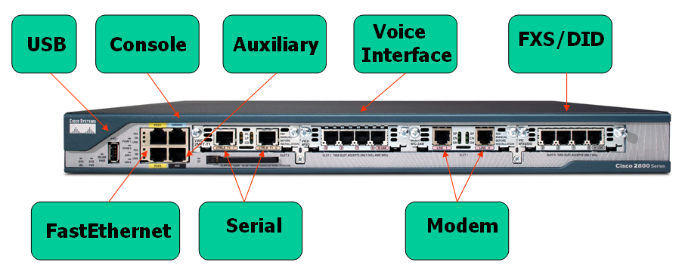
Router Interface
Cisco 2800 Series Router - Interface

Slide 79
Router Interface
Console input—This input provides an RS-232 serial communications link into the router for initial router configuration. This router is also showing a USB input.

Slide 80
Router Interface
Auxiliary input—This input is used to connect a dial-in modem into the router. The auxiliary port provides an alternate way to remotely log into the router if the network is down. This port also uses an RJ-45 connection.

Slide 81
Router Interface
Serial Input - This is a serial connection and it has a built-in CSU/DSU. This interface is used to provide a T1 connection to the communications carrier. (Note: The CSU/DSU function is presented in Chapter 10.) This type of connection (RJ-45) replaces the older cabling using V.35 cable

Slide 82
Router Interface
FastEthernet Input – These are 100 Mbps interfaces for the router.

Slide 83
Router Interface
Voice Interface Card (VIC2-4FXO) – This interface shows 4 phone line connections. This router can be programmed as a small PBX (Private Branch Exchange) for use in a small office.

Slide 84
Router Interface
Modem - This interface has two RJ-11 jacks and has two V.90 analog internal modems. These modems can be used to handle both incoming and outgoing modem calls.

Slide 85
Router Interface
FXS/DID - This interface is a four-port FXS and DID voice/fax interface card. FXS is a Foreign Exchange Interface that connects directly to a standard telephone. DID is Direct Inward Dialing is a feature that enables callers to directly call an extension on a PBX.

Slide 86
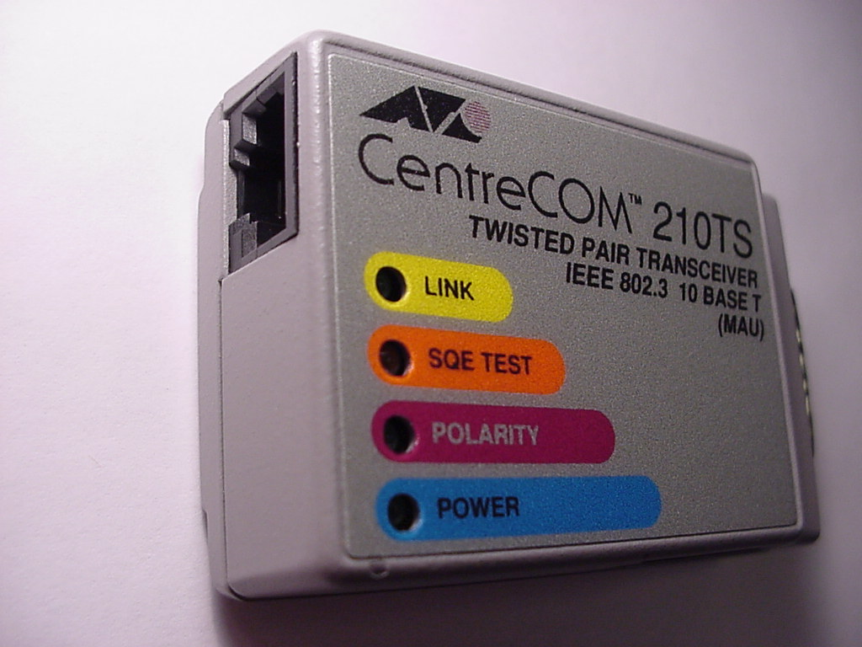
AUI port – This is a 10Mbps Ethernet port. AUI stands for Attachment Unit Interface.
A media converter is used to convert the 15-pin AUI port to the 8-pin RJ-45 connector. An example of an AUI to RJ-45 media converter is shown
Media converters are commonly used in computer networks to adapt layer 1 or physical layer technologies from one technology to another.
An AUI-to-twisted pair media converter.

Slide 87
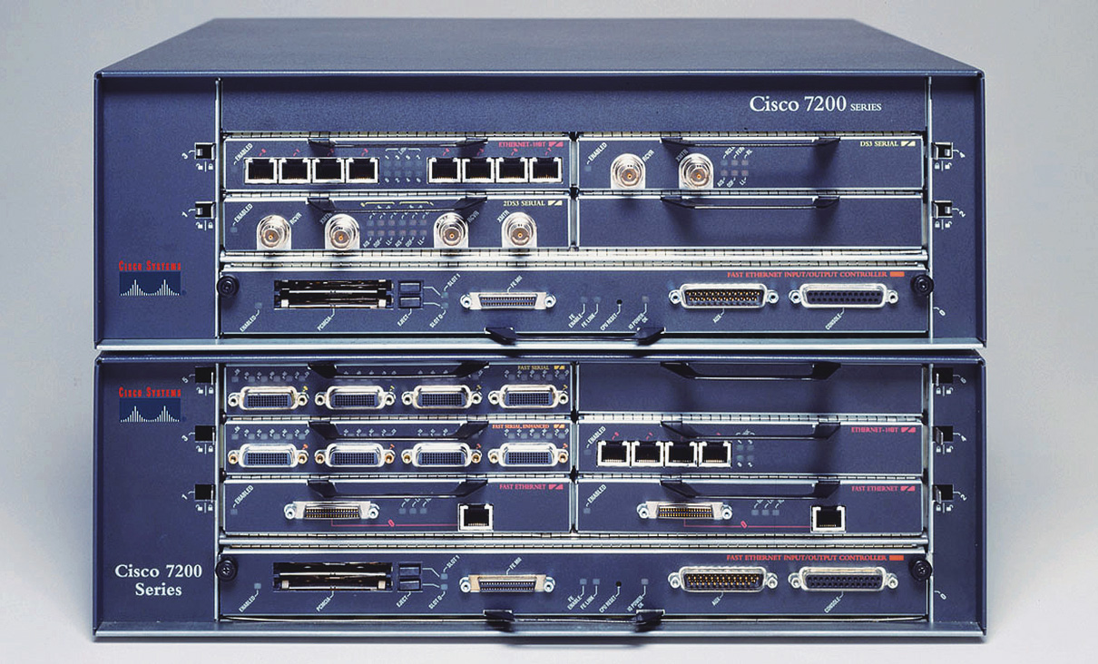
FIGURE 5-20 A Cisco 7200 series router.
(Courtesy of Cisco Systems.)

Slide 88
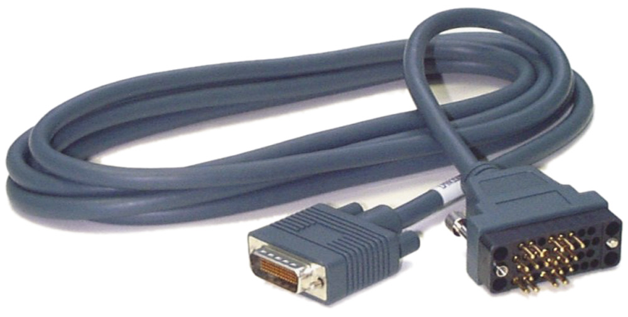
An example of a Cisco V.35 DTE cable.

Slide 89
Section 5-4 Key Terms
Network Address
Logical Address
Router Interface
AUI Port
Media Converter

Slide 90
Chapter 5-5
Interconnecting LANs with the Router

Slide 91
Routers - Review
A router routes data based on the destination network address or logical address rather than the physical address used by the layer 2 devices such as the switch and the bridge.
Information exchanged with bridges and layer 2 switches requires that the MAC address for the hosts be known.
Routed networks such as most enterprise and campus networks use IP addressing for managing the data movement. Enterprise network is a term used to describe the network used by a large company.
The use of the network or logical address on computers allows the information to be sent from a LAN to a destination without requiring that the computer know the MAC address of the destination computer. Remember, final delivery of data packets is based on knowing the MAC address of the destination.

Slide 92
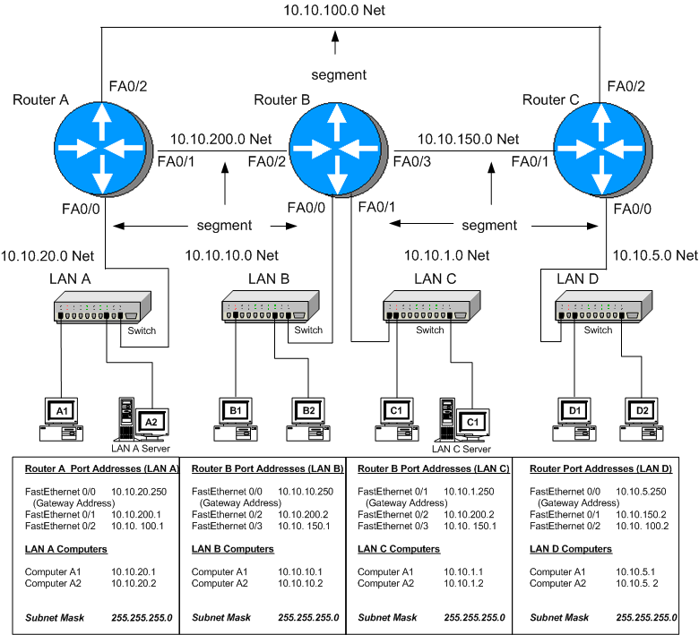

Slide 93
Router A connects directly to the LAN A switch via FastEthernet port FA0/0. Router A also
connects directly to Router B via the FastEthernet port FA0/1 and connects to Router C via FastEthernet port FA0/2.

Slide 94
Router B connects directly to the LAN B switch via FastEthernet port FA0/0. Router B also connects to the LAN C switch via FastEthernet port FA0/1. Router B connects directly to Router A via FastEthernet port FA0/2 and connects to Router C via FastEthernet port FA0/3.

Slide 95
Router C connects directly to the LAN D switch via the FastEthernet port FA0/0. Router C also connects to Router A via FastEthernet port FA0/2. Connection to Router B is provided via FastEthernet port FA0/1.

Slide 96
Serial Ports
The serial ports (s0, s1, s2 …) are not being used to interconnect the routers in this example campus network. The serial interfaces are typically used to interconnect LANs that connect through a data communications carrier such as a telephone company.

Slide 98
Routing Tables
Delivery of the information over the network is made possible by the use of an IP address and routing tables. Routing tables keep track of the routes to used for forwarding data to its destination.

Slide 100
Gateway Address
The term gateway is used to describe the address of the networking device that enables the hosts in a LAN to connect to networks and hosts outside the LAN. For all hosts in LAN A the gateway address will be 10.10.10.250.

Slide 102
Network Segment
The network segment defines the networking link between two LANs. There is a segment associated with each connection of an internetworking device (e.g. router-hub, router-switch, router-router).
For example, the IP address for the network segment connecting LAN A to the router is 10.10.20.0. All hosts connected to this segment must contain a 10.10.20.x since a subnet mask of 255.255.255.0 is being used. Subnet masking is fully explained in Chapter 5.

Slide 104
Section 5-5 Key Terms
Enterprise Network
Ethernet Port (E0, E1, E2, …
Serial Port (S0, S1, S2, …)
Routing Table
Gateway

Slide 105
Chapter 5-6
Configuring the Network Interface – Auto-negotiation

Slide 106
Auto-negotiation
Most modern networking internetworking technologies (e.g. hubs, switches, bridges, routers) now incorporate the auto-negotiation protocol.
The protocol enables the Ethernet equipment to automate many of the installation steps. This includes automatically configuring the operating speeds (e.g. 10/100/1000 Mbps) and the selection of full or half duplex operation for the data link.
The auto-negotiation protocol is defined in the IEEE Ethernet standard 802.3x for Fast Ethernet.

Slide 107
Fast-Link Pulse
The auto-negotiation protocol uses a fast link pulse (FLP) to carry the information between each end of a data link. The data rate for the fast link pulses is 10 Mbps, the same as for 10BaseT.
The fast link pulses were designed to operate over the limited bandwidth supported by CAT3 cabling.
Therefore, even if a link is negotiated, there is no guarantee that the negotiated data rate will work over the link. Other tests on the cable link must be used to certify the cable can carry the negotiated data link configuration (refer back to Chapter 2).

Slide 108
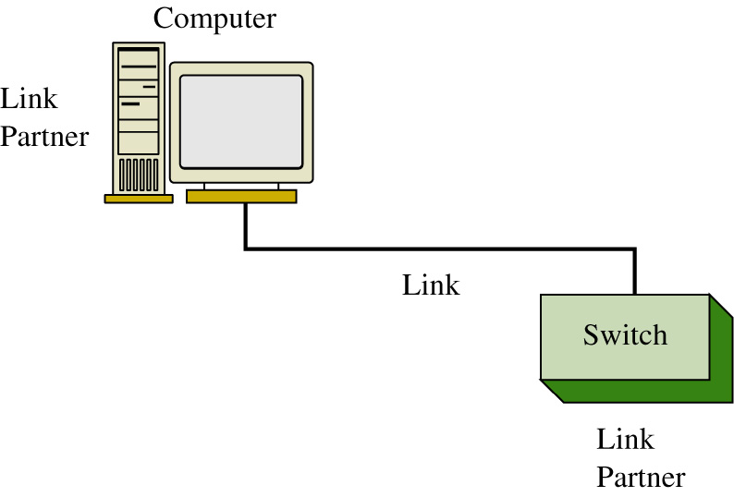
Auto-negotiation
Each link partner shares or advertises its data link capabilities with the other link partner.
The two link partners then use the advertised capabilities to establish the fastest possible data link rate for both links.

Slide 109
Auto-negotiation
For example, in the example of the link partners shown, computer 1 advertises that its interface supports 10BaseT (10Mbps).
The switch advertises that it supports both 10BaseT and 100BaseTX (100Mbs).

Slide 110
Auto-negotiation
The network interfaces on each link partner are set for auto-negotiation, therefore the 10BaseT operating mode is selected.
This is the fastest data rate that can be used in this data link. The data rate is limited by the 10BaseT capabilities of the computer’s network interface.

Slide 111
Auto-negotiation
Note: Auto-negotiation takes place when an Ethernet link is established. The link information is only sent one time, when the link is established.
The negotiated link configuration will remain until the link is broken or the interfaces are reconfigured.

Slide 112
Full Duplex / Half-Duplex
Modern network interfaces for computer networks have the capability of running the data over the links in either full or half duplex mode.
Full duplex means that the communications device can transmit and receive at the same time.
Half duplex mode means the communications device can transmit or receive but not at the same time.

Slide 113
Full Duplex / Half-Duplex
100 Base T
Pin 1 | TX-D1 +
Pin 2 | TX-D1 -
Pin 3 | RX-D2 +
Pin 4 | BI-D3 +
Pin 5 | BI-D3 -
Pin 6 | RX-D2 -
Pin 7 | BI-D4 +
Pin 8 | BI-D4 -
In full duplex operation, the media must have separate transmit and receive data paths. This is provided for in 100Base T signals with pairs 1-2 (transmit) and pairs 3-6 (receive). The remaining pins configurations are listed.

Slide 114
Full Duplex / Half-Duplex
1000 Base T
Pin 1 | BI-D A+
Pin 2 | BI-D A-
Pin 3 | BI-D B+
Pin 4 | BI-D C+
Pin 5 | BI-D C-
Pin 6 | BI-D B-
Pin 7 | BI-D D+
Pin 8 | BI-D D-
In 1000BaseT applications the bi-directional data for full duplex operation is provided as shown:

Slide 115
Full Duplex / Half-Duplex
An important note is that the full duplex mode in computer network links is only for point-to-point links. This means that there can only be two end stations on the link. The CSMA/CD protocol is turned off, therefore there can’t be another networking device competing for use of the link.
An example of networking devices that can run full duplex are computers connected to a switch. The switch can be configured to run the full duplex mode. This also requires that each end station on the link must be configurable to run full duplex mode.

Slide 116
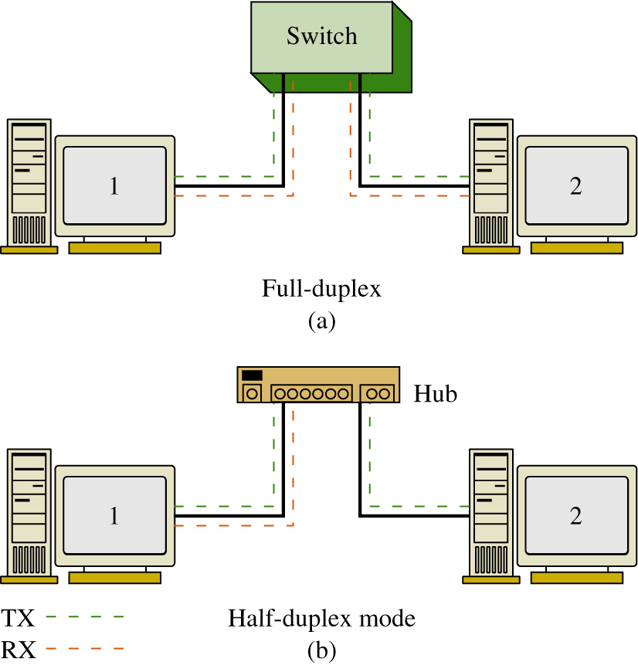
Full Duplex / Half-Duplex
In half duplex operation, the link uses the CSMA/CD protocol. This means only one device talks at a time and while the one device is talking, the other networking devices “listen” to the network traffic.
In full duplex operation (a), CSMA/CD is turned off and computers 1, 2, and the switch are transmitting and receiving at the same time. In half duplex mode (b), CSMA/CD is turned on, computer 1 is transmitting, and computer 2 is “listening” or receiving the data transmission.

Slide 117
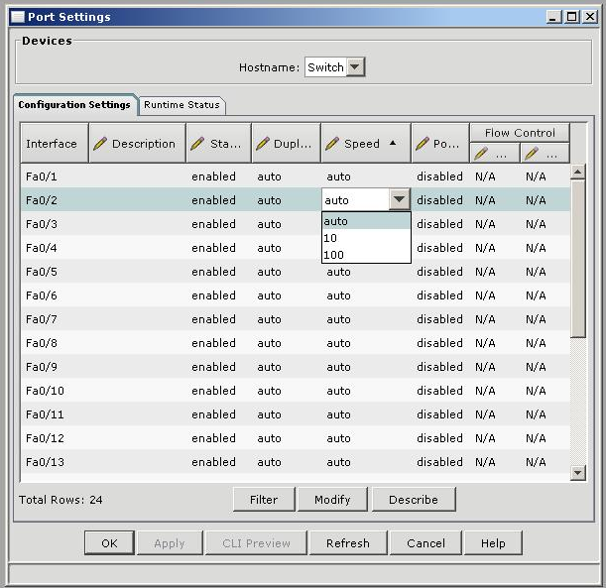
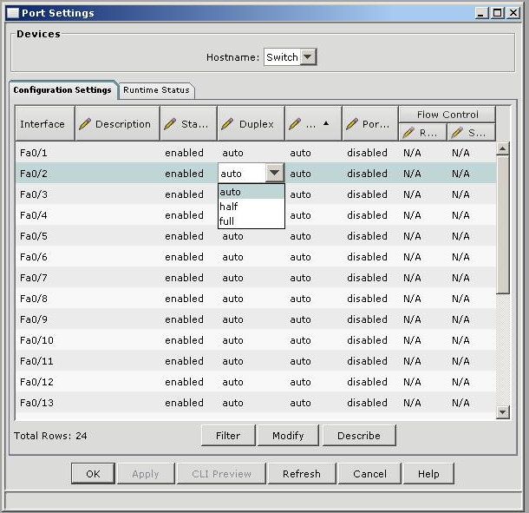
Port Management
An example of the port management options available with a Cisco switch: (a) speed - auto, 10, and 100 Mbps (b) duplex - auto, half, and full negotiation.

Slide 118
Summary
Advantages
  useful in LANs that have multiple users with multiple connection capabilities
  the auto-negotiation feature can maximize the data links throughput
Disadvantages
  not recommended for fixed data links such as the backbone in a network
  a failed negotiation on a functioning link can cause a link failure

Slide 119
Section 5-6 Key Terms
Auto-negotiation
Fast Link Pulse (FLP)
Full Duplex / Half Duplex

